Slide 1

What problems are we trying to solve?
SEMANTIC TECHNOLOGY
Short answer: We need to effectively automate the processes of finding, exchanging, disseminating and working with data.

Slide 2
Controlled Vocabularies
Ontologies
Reasoning Engines(?)
Notes:
The technologies that many people think of immediately are controlled vocabularies and ontologies. May be reasoning engines. There are lots of technologies that fall into the spectrum of semantic technologies. What makes them “semantic” is that they are all aimed at ascribing meaning to otherwise meaningless text.

Slide 3

fhre0ncv!mpa
r8ehts#vtt7x
fie
????
????
Uqb%lrcx87rp
ywefi$alvn2
fie
????
????
mpal3wn*bieg
lacb@!qzfhem
fie
????
????
Notes:
It’s important to keep in mind that to computers It’s a lot like getting a text message of some random string of meaningless characters. All you can do here is check to see if it conforms to some syntactic criteria, but the string is otherwise uninterpretable.

Slide 4
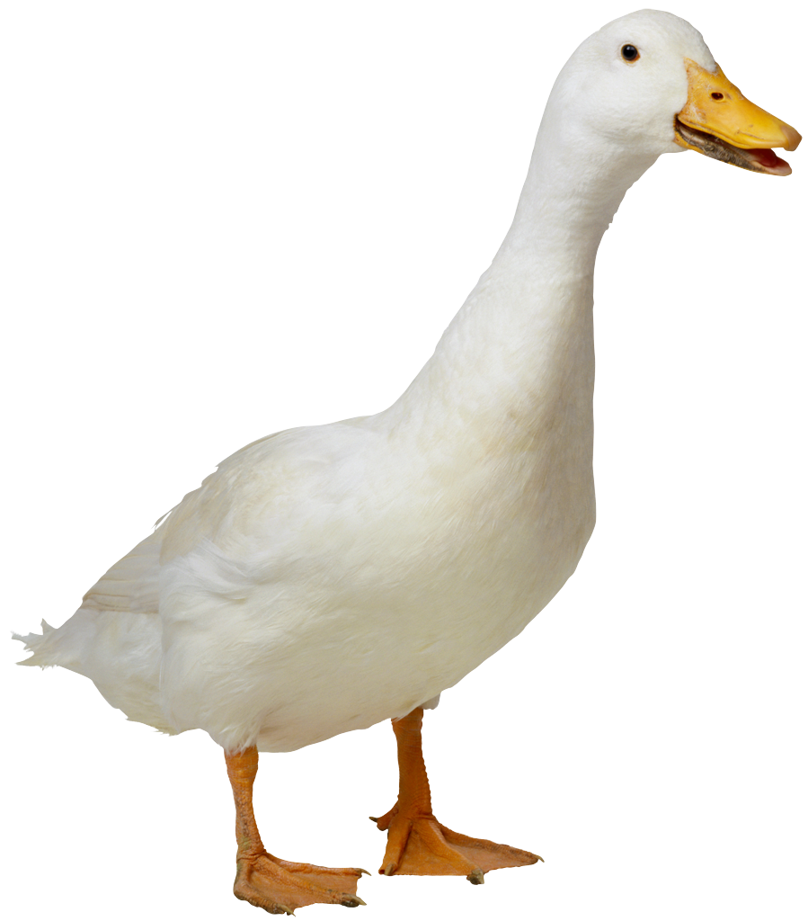
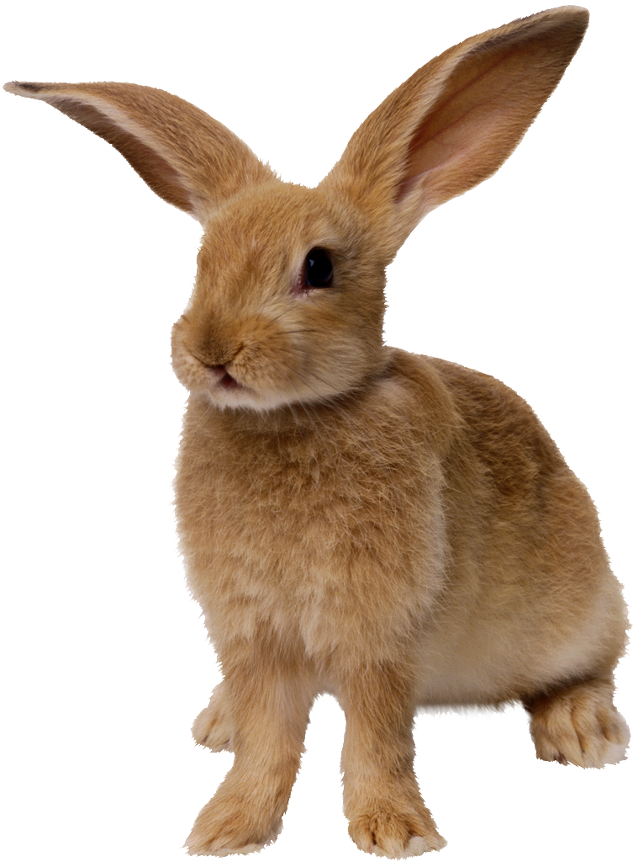
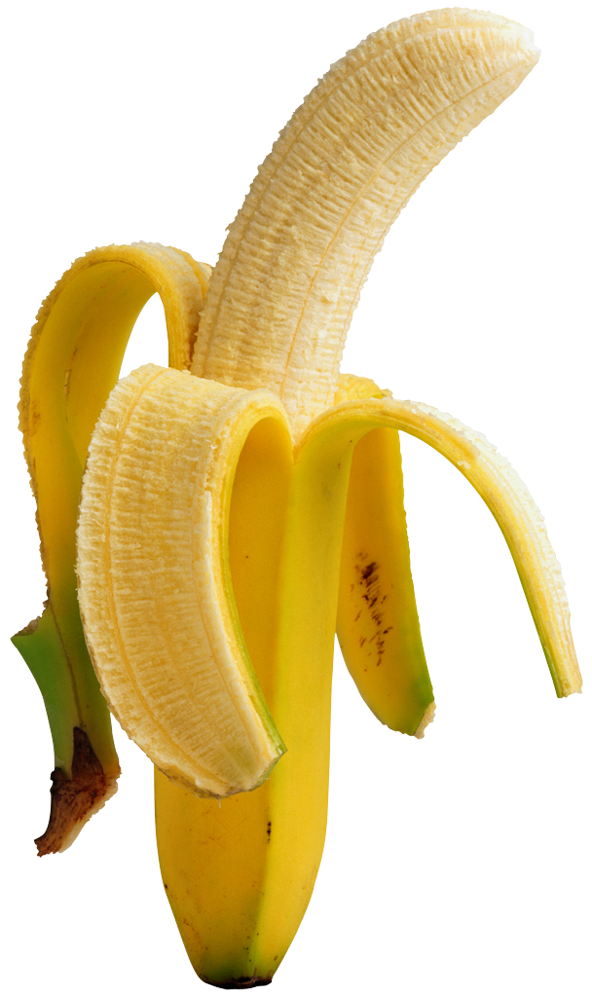

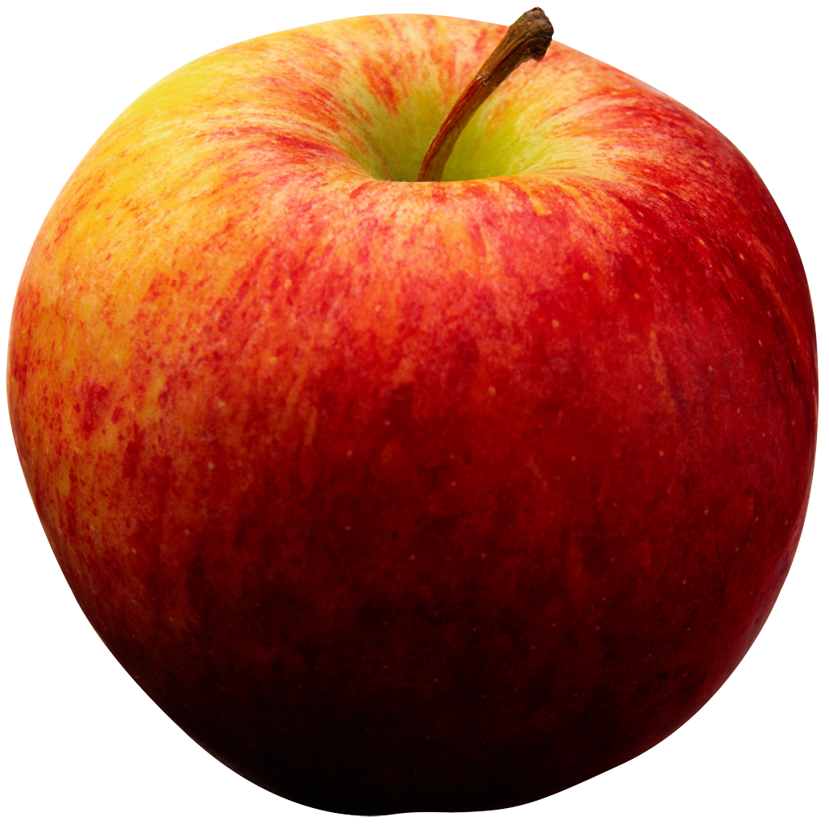

fhre0ncv!mpa=
r8ehts#vtt7x=
fhre0ncv!mpa
r8ehts#vtt7x
fie
Got it!
Got it!
Uqb%lrcx87rp=
ywefi$alvn2=
Uqb%lrcx87rp
ywefi$alvn2
fie
Got it!
Got it!
mpal3wn*bieg=
lacb@!qzfhem=
mpal3wn*bieg
lacb@!qzfhem
fie
Got it!
Got it!

Slide 5
Add meaning and:
World Wide Web→
Semantic Web
“The Web can reach its full potential only if it becomes a place where data can be shared and processed by automated tools as well as by people.” https://www.w3.org/2001/sw/Activity
Notes:
We want to develop capabilities like these But it’s important to keep in mind that all this is really in service of another sort of goal (or at least in the Earth Sciences and other sciences): how can we get more out of data. How can we learn things from

Slide 6
Linked Data→
Meaningfully Linked Data
Notes:
We want to develop capabilities like these But it’s important to keep in mind that all this is really in service of another sort of goal (or at least in the Earth Sciences and other sciences): how can we get more out of data. How can we learn things from

Slide 7
Search→
Intelligent Search
Notes:
We want to develop capabilities like these But it’s important to keep in mind that all this is really in service of another sort of goal (or at least in the Earth Sciences and other sciences): how can we get more out of data. How can we learn things from

Slide 8
Statistical Analyses→
Entity Recognition, Classification Systems
Notes:
We want to develop capabilities like these But it’s important to keep in mind that all this is really in service of another sort of goal (or at least in the Earth Sciences and other sciences): how can we get more out of data. How can we learn things from

Slide 9
Getting there has proven to be hard!
mpal3wn*bieg
r8ehts#vtt7x
ywefi$alvn2
lacb@!qzfhem
Uqb%lrcx87rp
fhre0ncv!mpa
Notes:
If we all assign the same term to the same thing, and promise stick with it, then we’ll all understand each other. Lots of work has been done in developing controlled vocabularies.

Slide 10


r8ehts#vtt7x
7ytw4ugd
fhre0ncv!mpa
fhre0ncv!mpa
wivydfh4z
ywefi$alvn2
lacb@!qzfhem
lacb@!qzfhem
Uqb%lrcx87rp
mpal3wn*bieg
Notes:
Adoption has been a significant problem

Slide 11
wivydfh4z
fie
Got it!
Notes:
Resulting in semantic mismatches. This has fed the lack of enthusiasm that semantic technologies is sometimes met with.

Slide 12
Linked Data
Search
Natural Language Processing
Machine Learning
Controlled Vocabularies
Ontologies
Computational Semantics
Notes:
There are lots of technologies that fall into the spectrum of semantic technologies. What makes them “semantic” is that they are all aimed at ascribing meaning to otherwise meaningless text.

Slide 13
Where to go from here?
Urge everyone to think about semantics in terms of the big picture:
How do we overcome the current barriers to success:
-Adoption
-Scalability
-Integration
Notes:
In the early days, there was some tension between the computational semantics faction and the machine learning faction. But recent years have seen efforts to combine the various techniques

Slide 14

How do we bring semantics to bear on real-life use cases?

